Slide 1
Photo Album
by Sohel Rana

Slide 2
https://www.marktechpost.com/free-ai-ml-deep-learning-video-lectures/?fbclid=IwAR223hUWTLDrBghsj4nxffBcEb8HgXu0Oo5ER1PN_pzV-gs6ZKthQZlxVmU

Slide 3
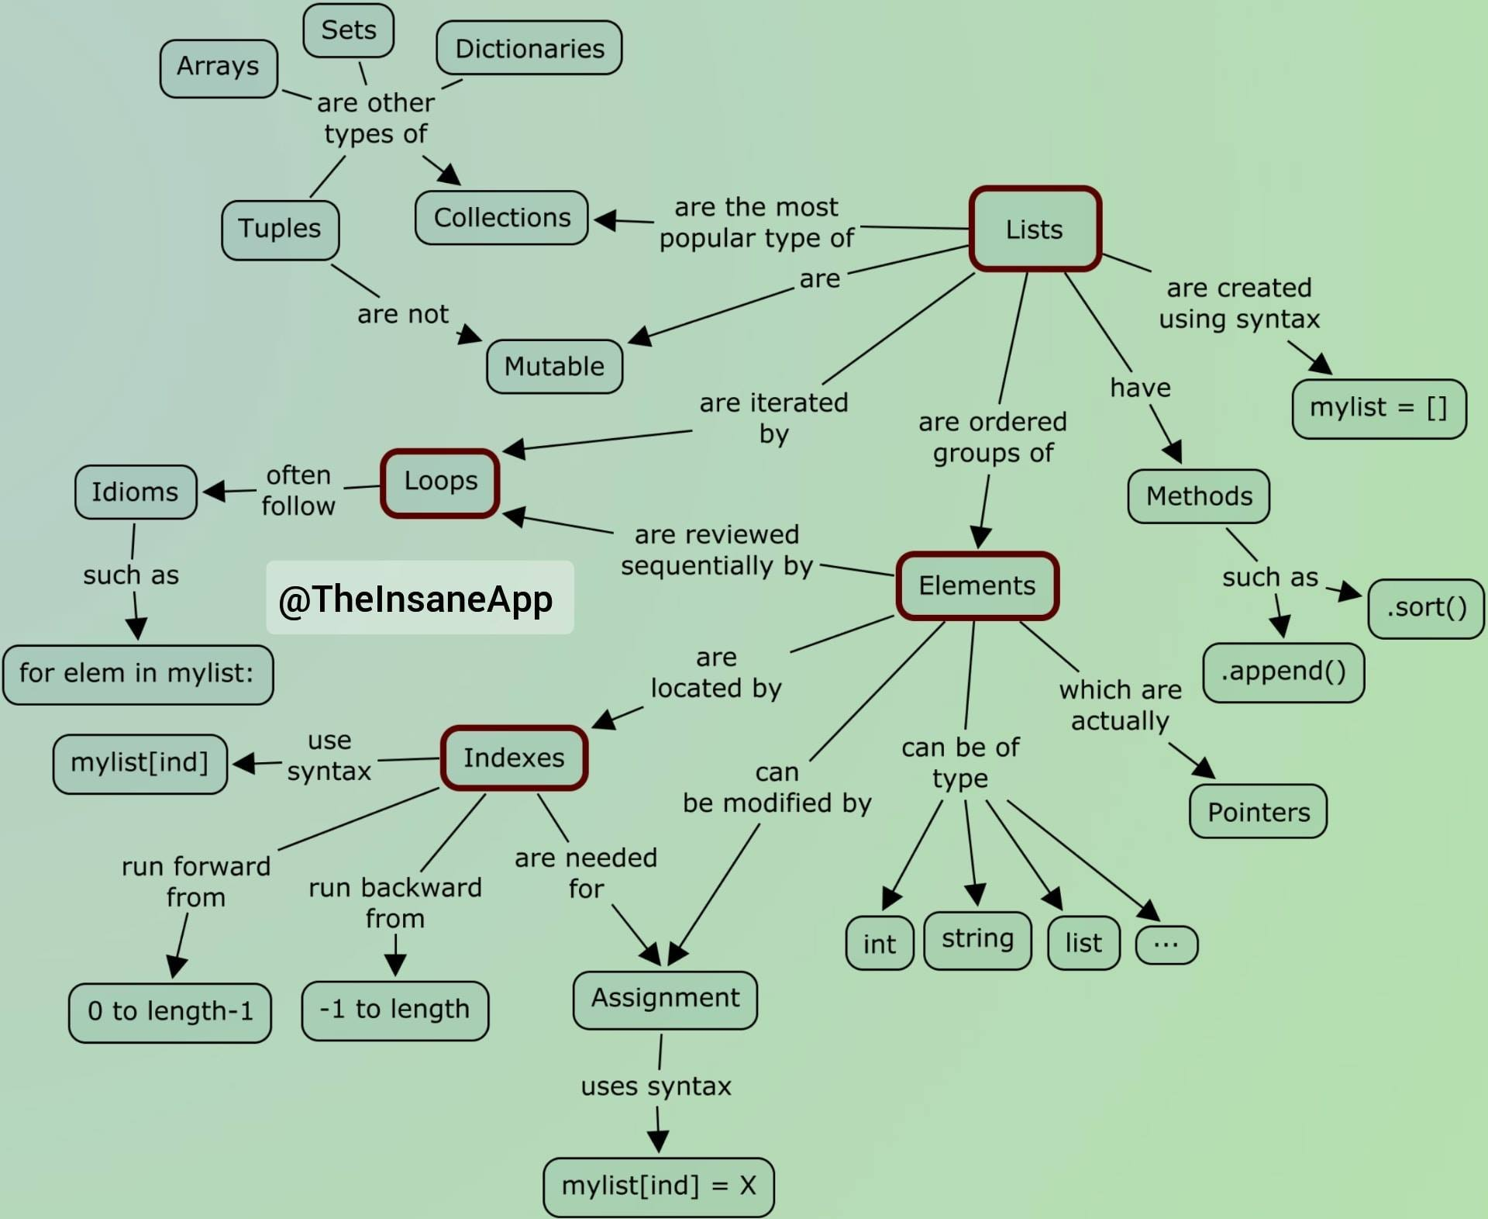

Slide 4
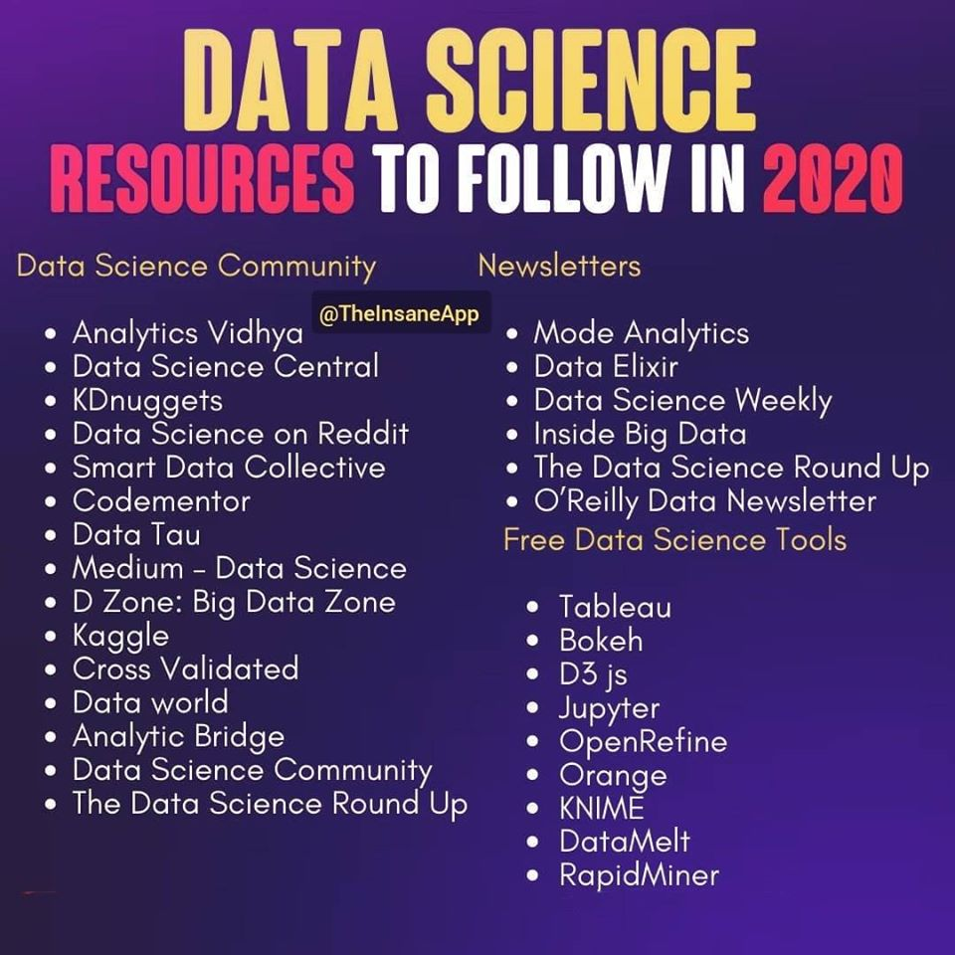

Slide 5
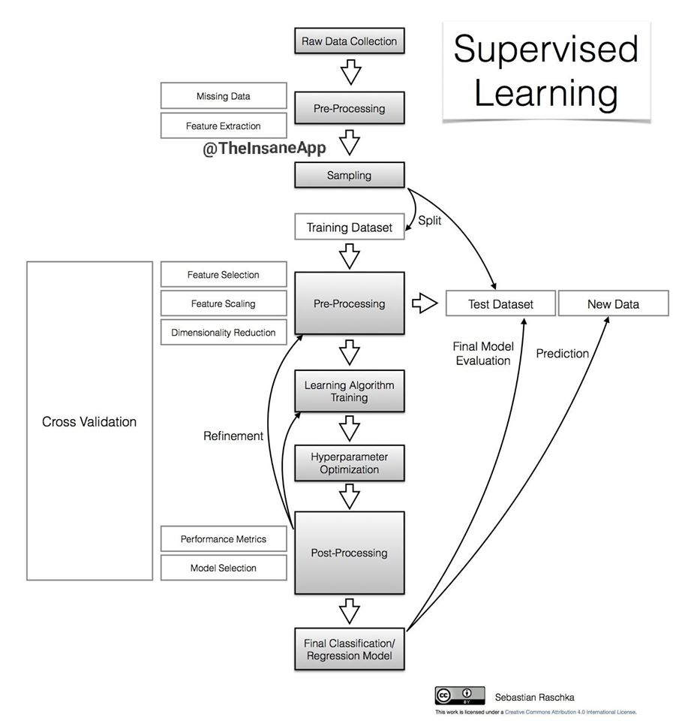

Slide 6
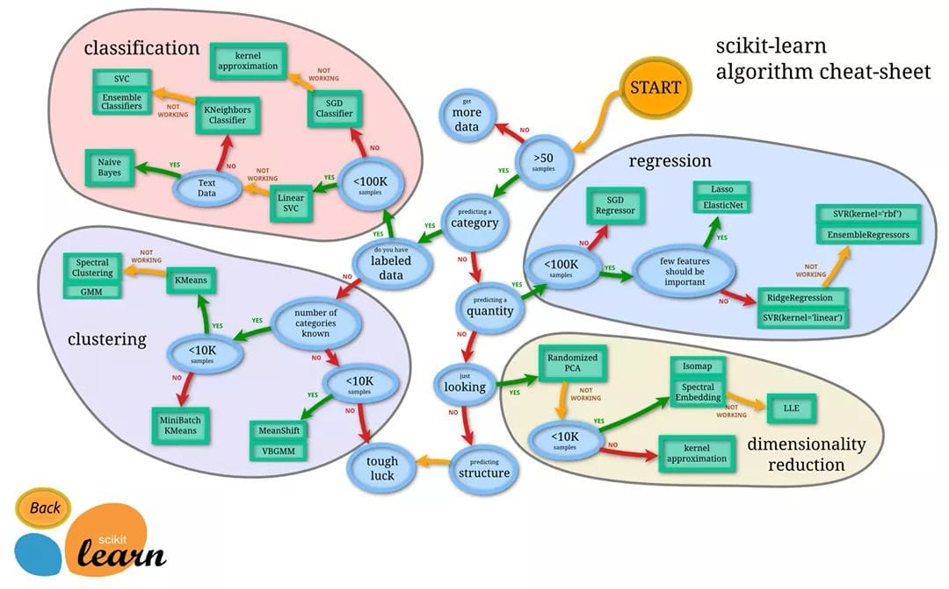

Slide 7
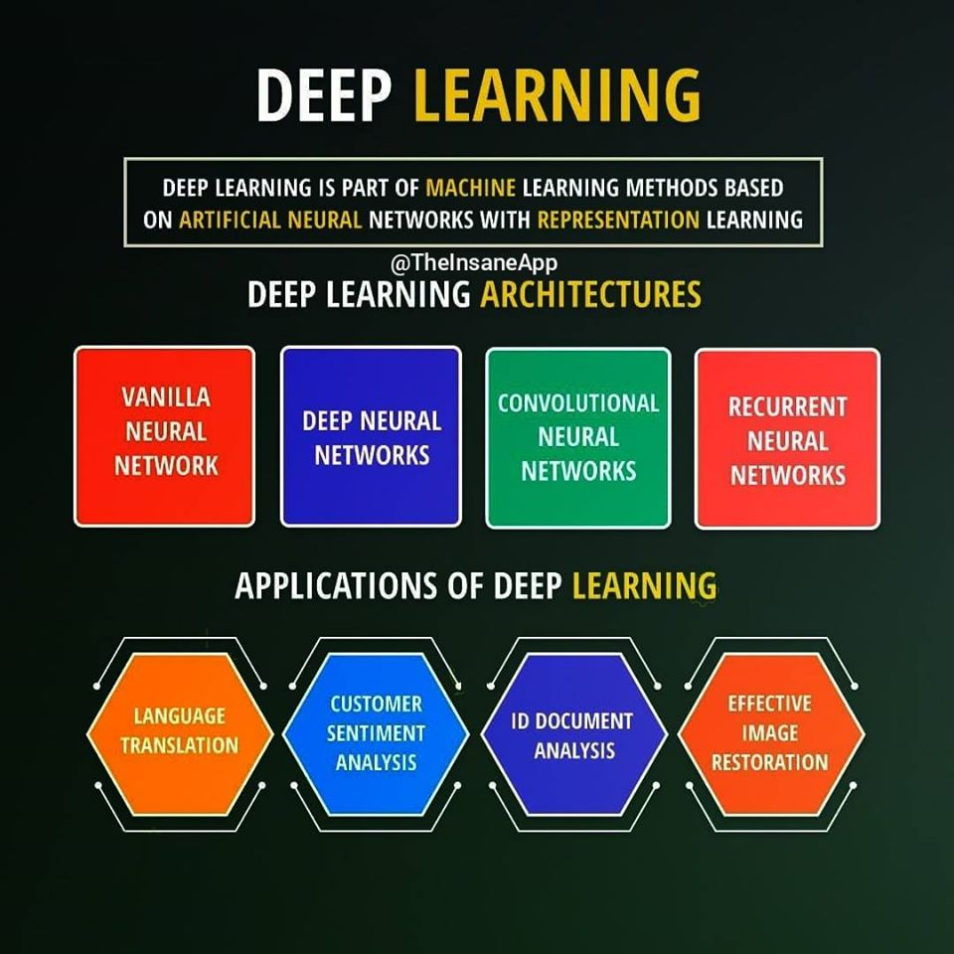

Slide 8
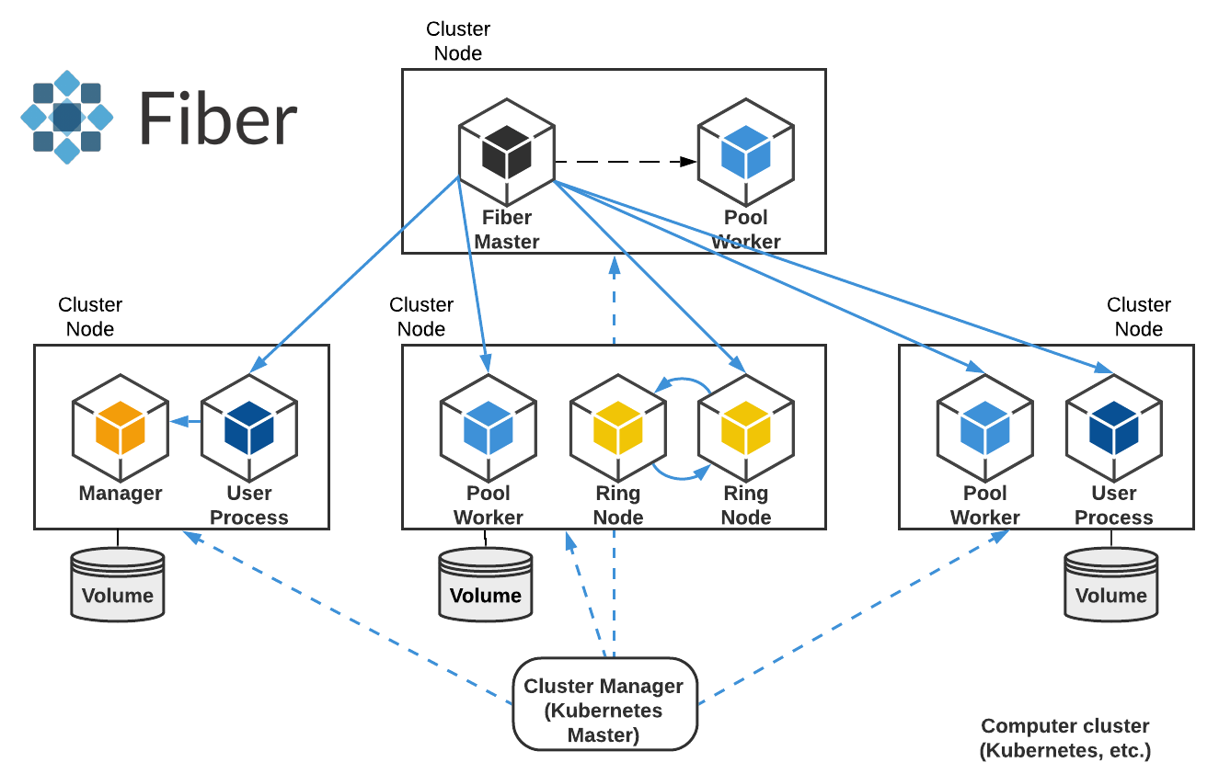

Slide 9
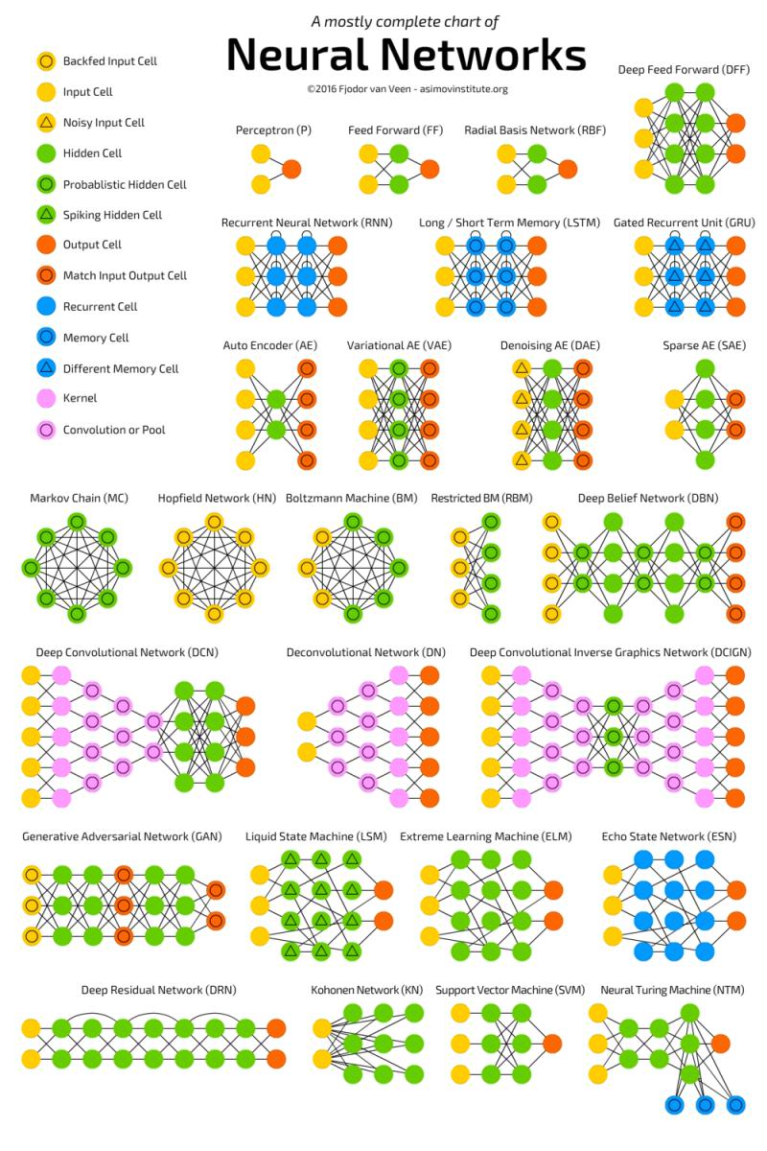

Slide 10
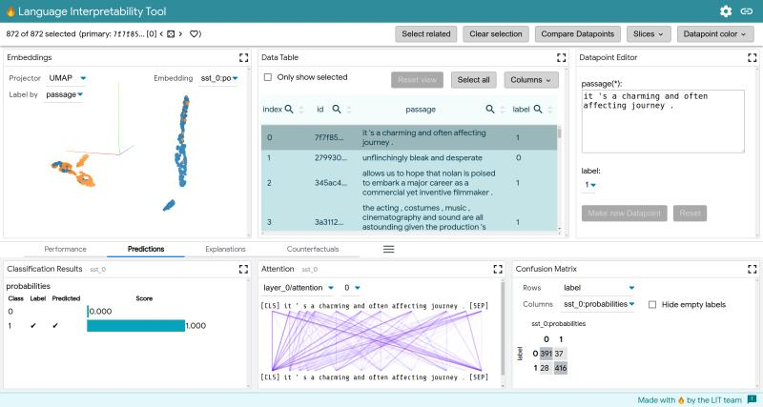

Slide 11
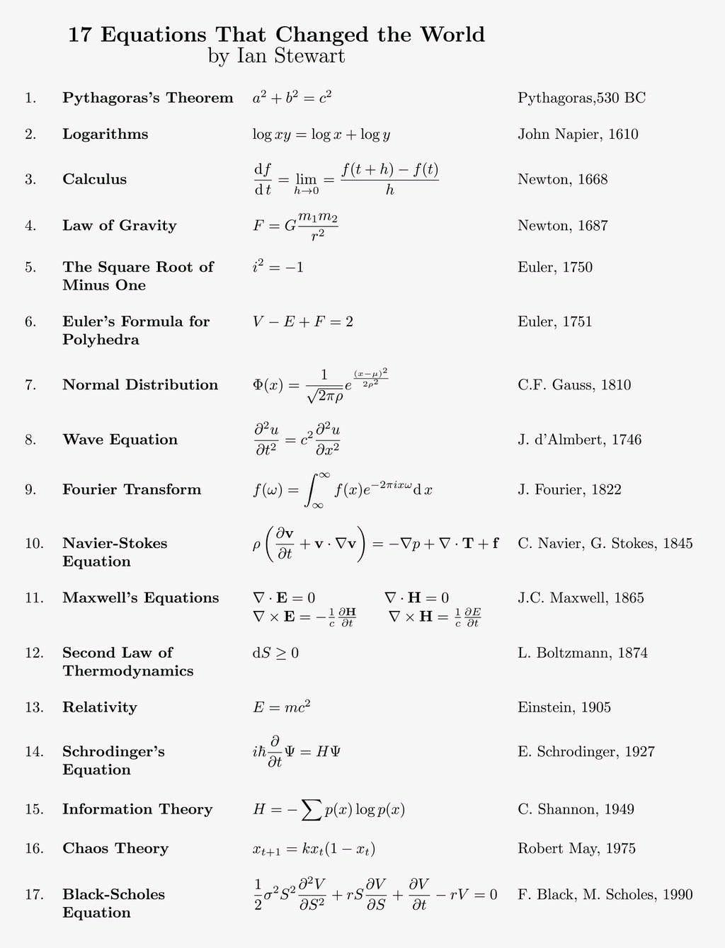

Slide 12
